Slide 1
REPUTATION MANAGEMENT
with
Helping Small Businesses
Get More 4 and 5 Star Reviews,
Attract More Customers, And
Grow Their Revenue

Slide 2
When Potential Customers and Clients Check You Out Online…
Do You Know What They Are Seeing?

Slide 3
It’s widely documented that online reviews must be an integral part of your marketing strategy.
Consumers love online reviews, and they use them daily to gain insight on everything from Amazon products
to accountants, doctors, restaurants,
car dealerships and more...

Slide 4
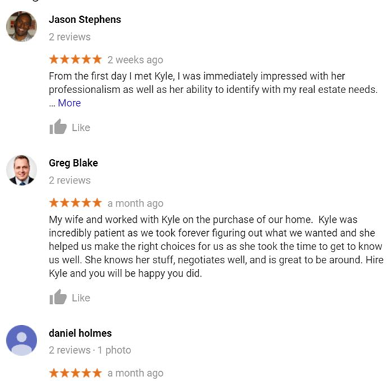
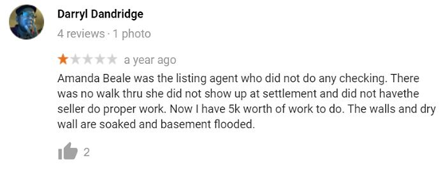
Are You Creating A Positive Impression Online?

Slide 5
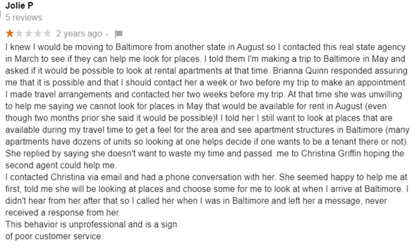
Are People Raving About Their Experience?
How old are your positive online reviews?
(Anything over 3 months is now considererd to be outdated!)

Slide 6
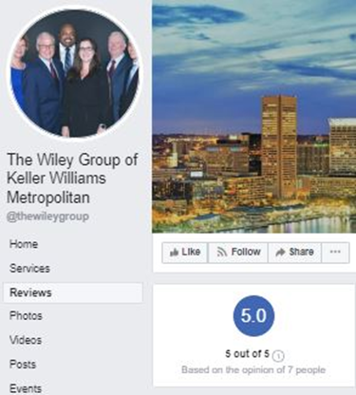
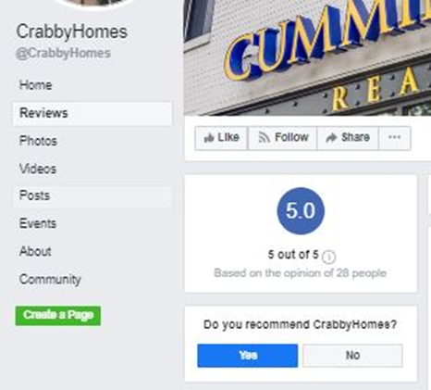
Does Your Online Brand Inspire Confidence?

Slide 7
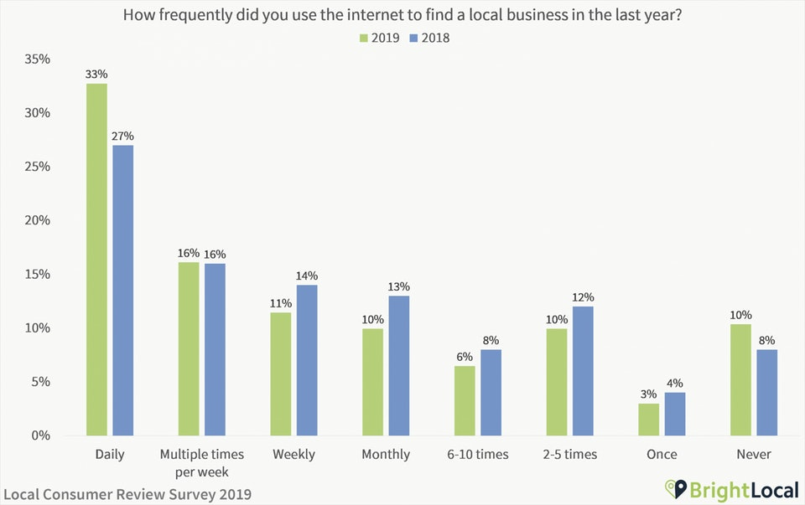
Online Word of Mouth Matters...
In 2019, 90% of consumers used the internet to find a local business in the last year.

Slide 8
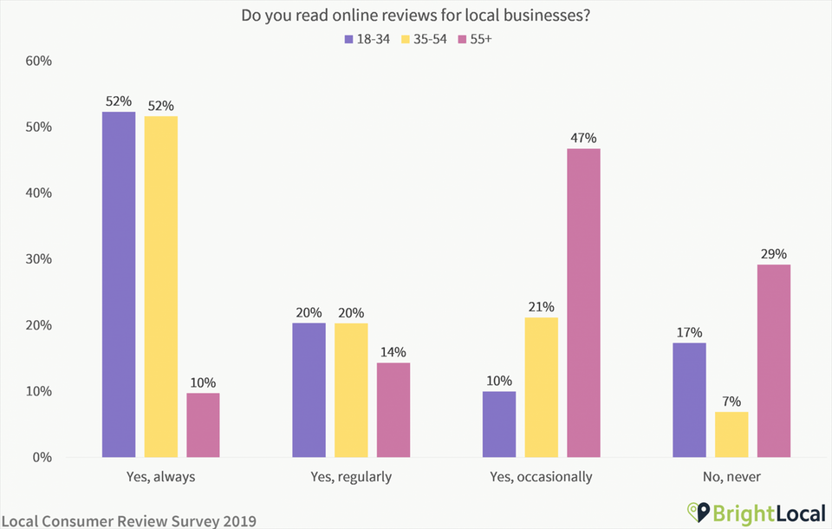
Online Word of Mouth Really Matters...
82% of consumers read online reviews for local businesses
52% of 18-54 year olds ‘always’ read local business reviews

Slide 9
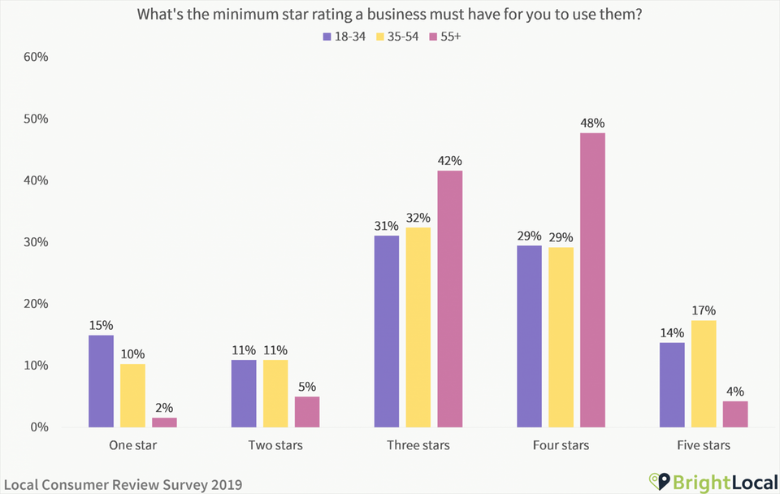
Online Word of Mouth Matters Tremendously...
91% of consumers say positive reviews make them more likely to use a business
Only 54% of people would consider using a business with less than a 4 star rating

Slide 10
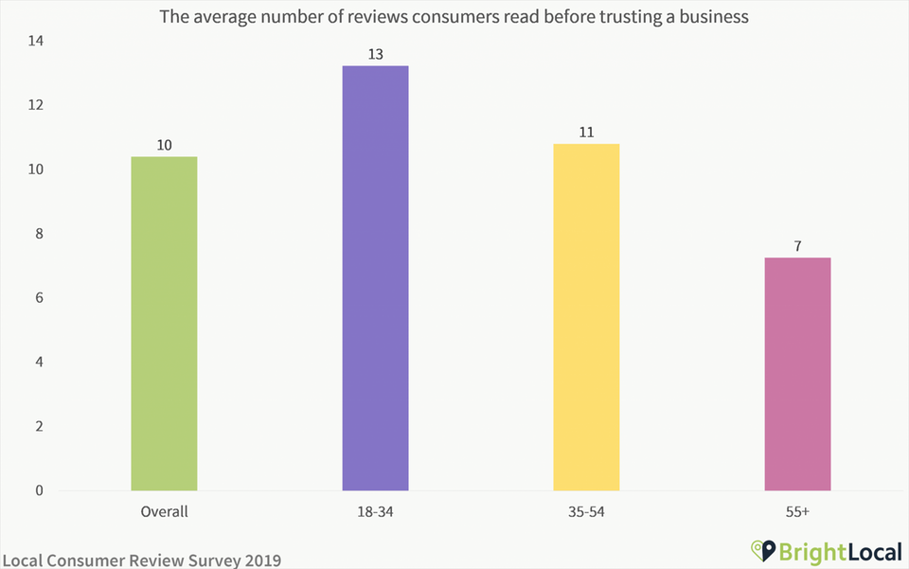
Psssst...Online Word of Mouth Matters!
A one star difference in your overall online rating can result in up to a 10% decrease or increase in business revenue
The average consumer reads 10 reviews before feeling able to trust a business.

Slide 11
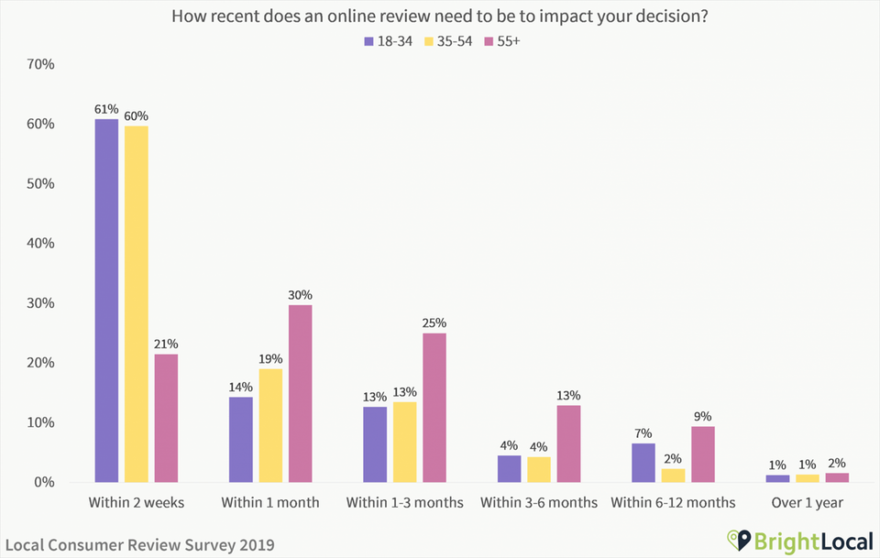
Online Word of Mouth Matters So Much...
48% of consumers only pay attention to reviews from the last 2 weeks
84% believe reviews older than 3 months are irrelevant

Slide 12
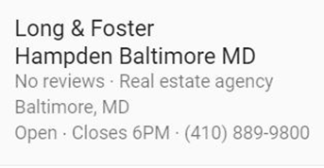
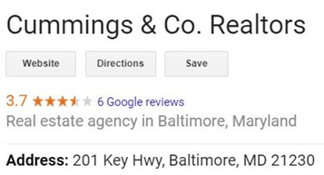
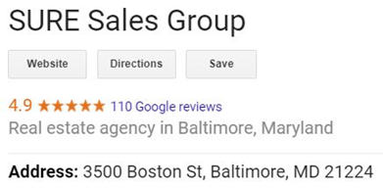
Which Company Would You Choose?

Slide 13
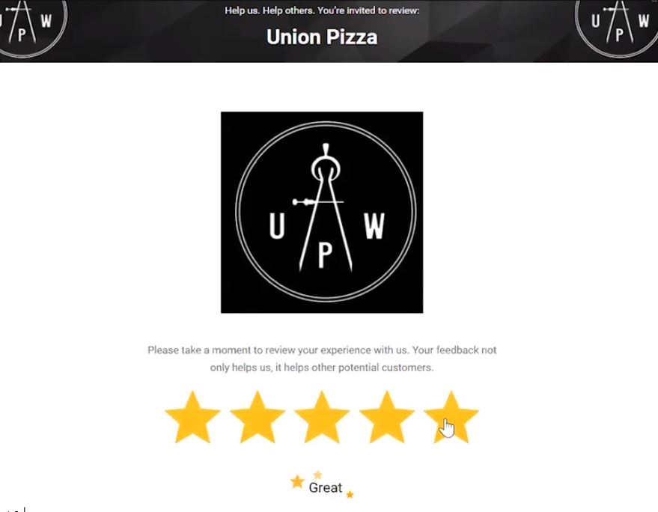
Our software automates the review getting process, the reputation
monitoring, and the reputation management tasks for you.
When a happy customer clicks 4 or 5 stars….

Slide 14
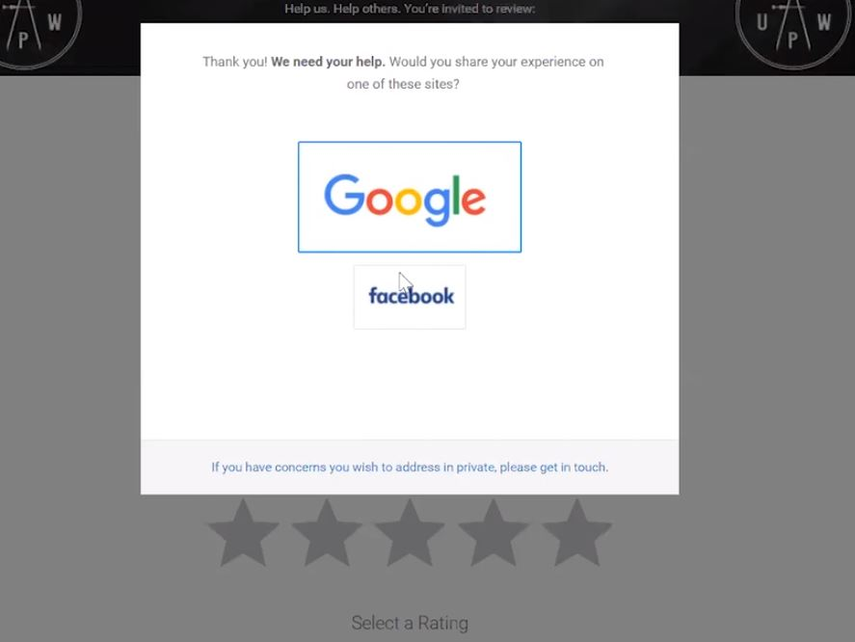
They are asked to choose a platform where they would like to share their feedback…

Slide 15
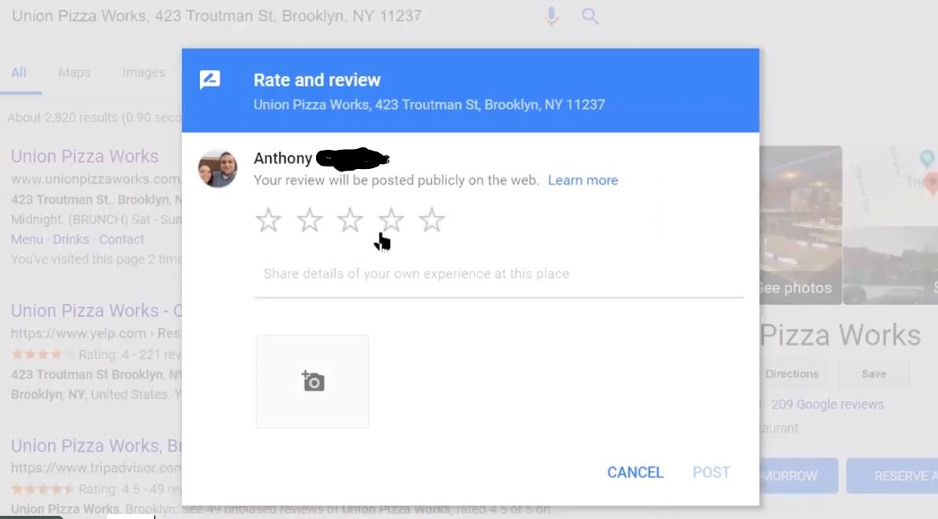

Slide 16
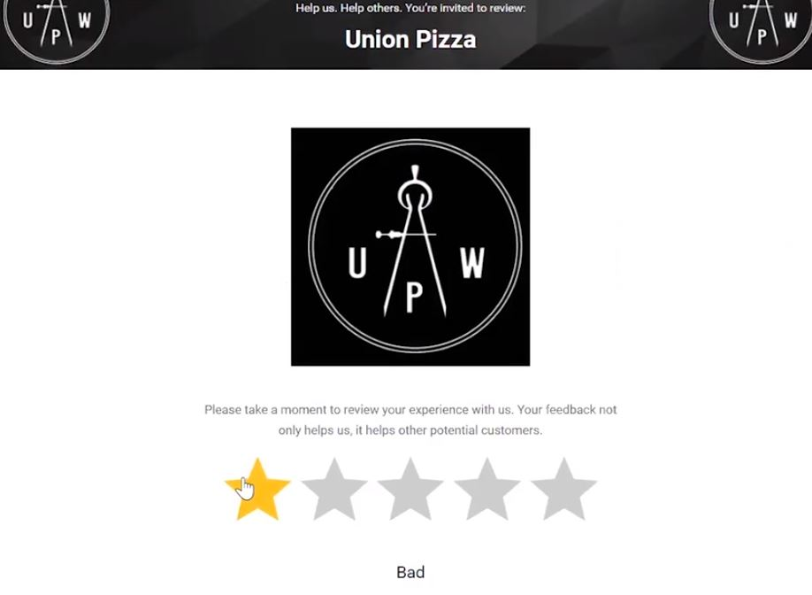
Unhappy customers who click 3 stars or less…..

Slide 17
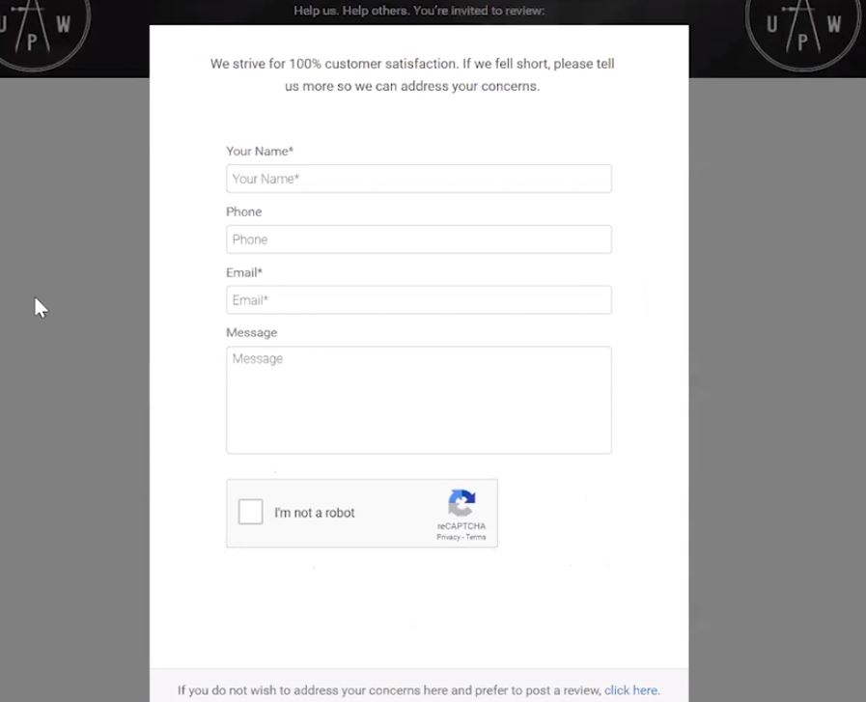
...are redirected to a private feedback page that is sent directly to you.

Slide 18
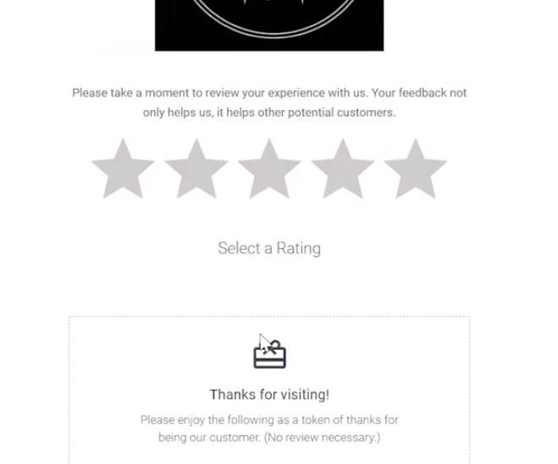
Optional: offer a discount for being a customer….

Slide 19
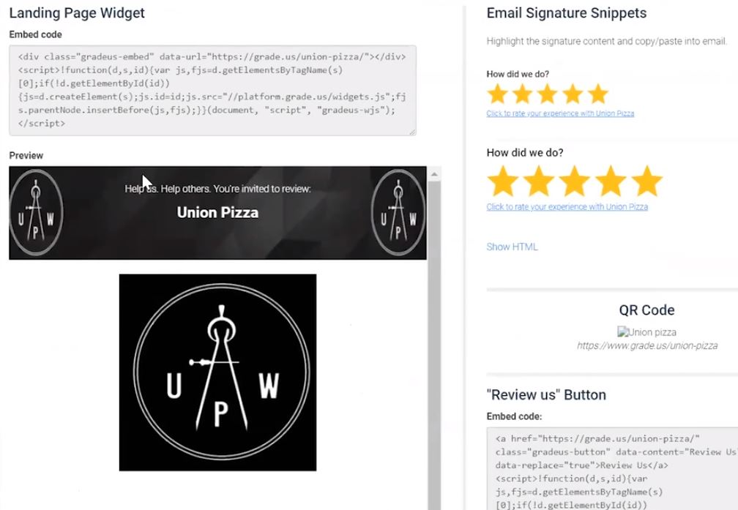
Ask for reviews directly on your website.
Ask for reviews with every email you send.

Slide 20
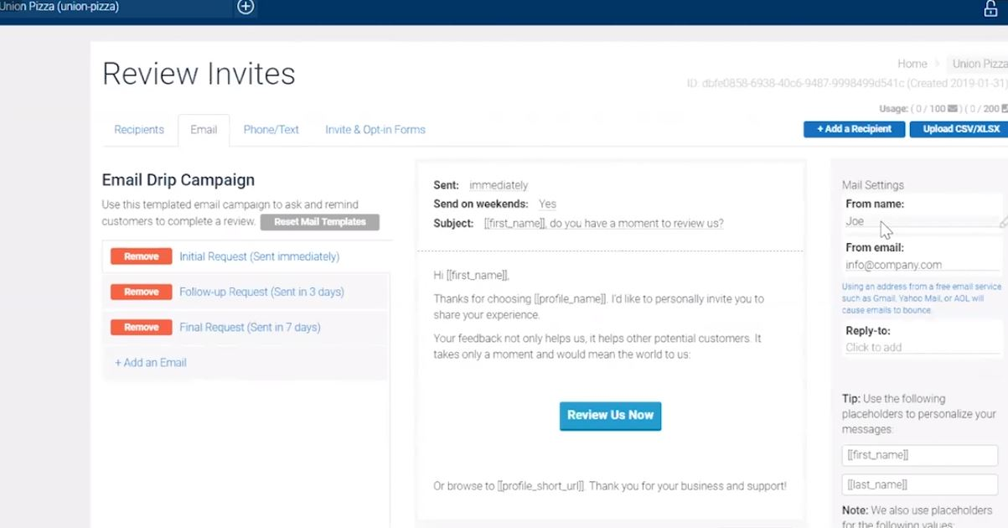
We send reminders to your customers if they
forget to give an online review.

Slide 21
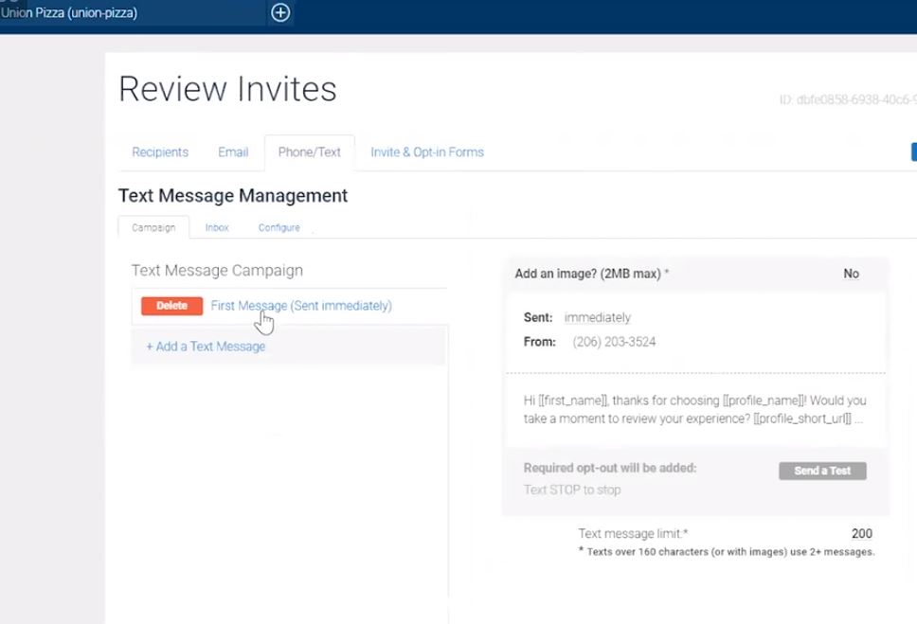

Slide 22
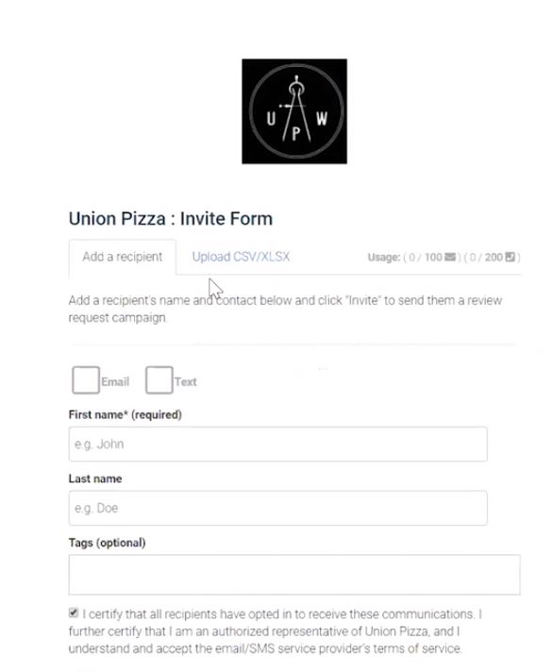
The business can upload their own client list or enter clients one by one.
We enter the clients for you.

Slide 23
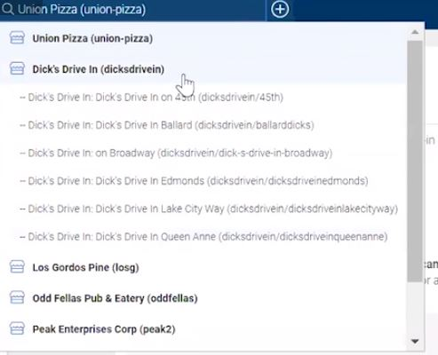
Multiple store locations?
Multiple sales reps?
No problem!

Slide 24
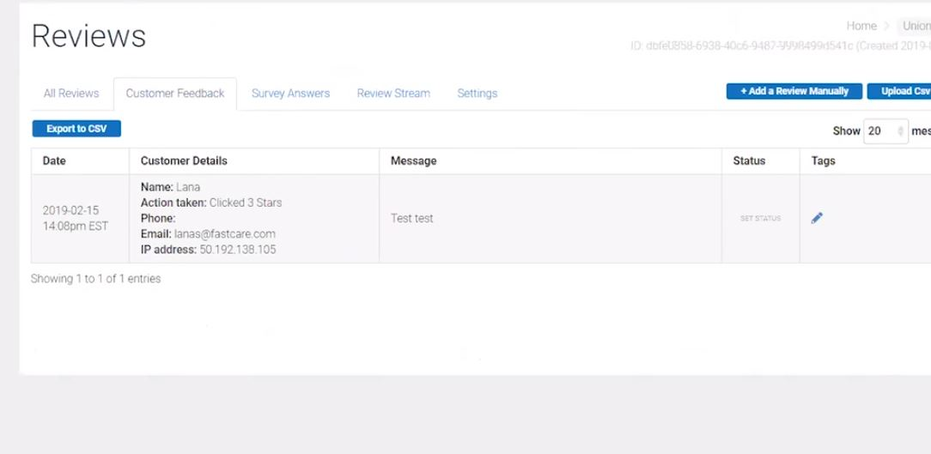

Slide 25
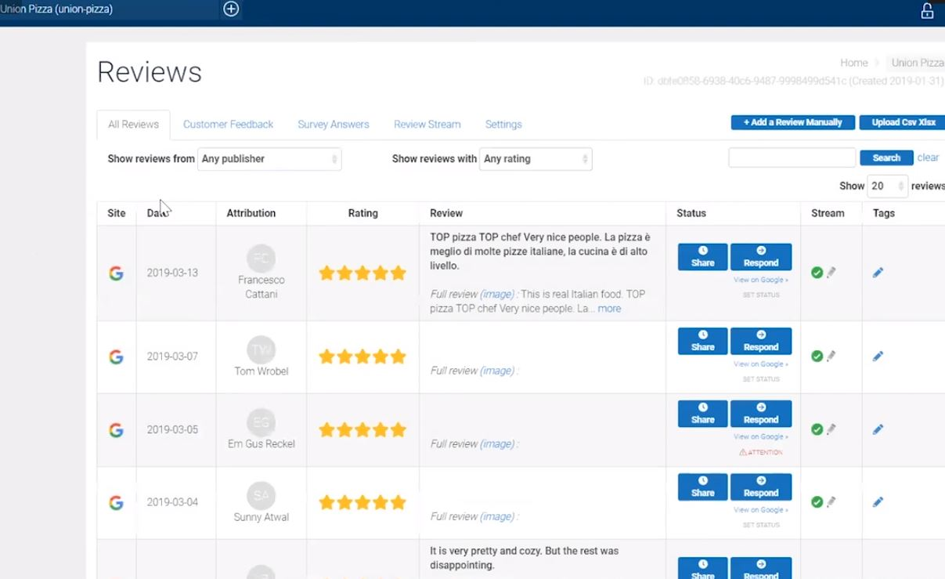
We can share and respond to customer reviews for you.

Slide 26
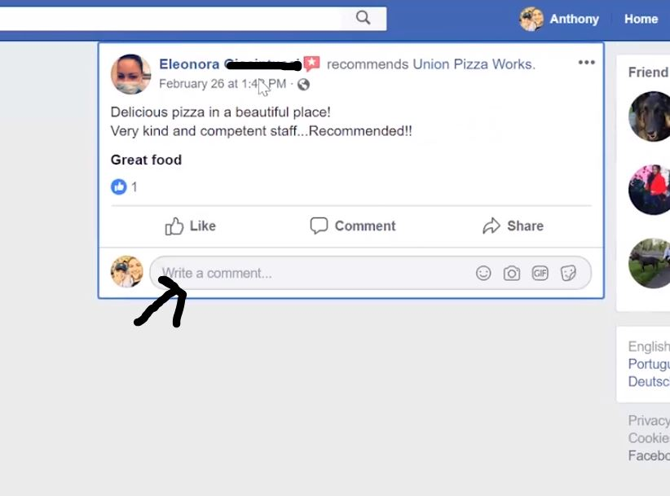

Slide 27
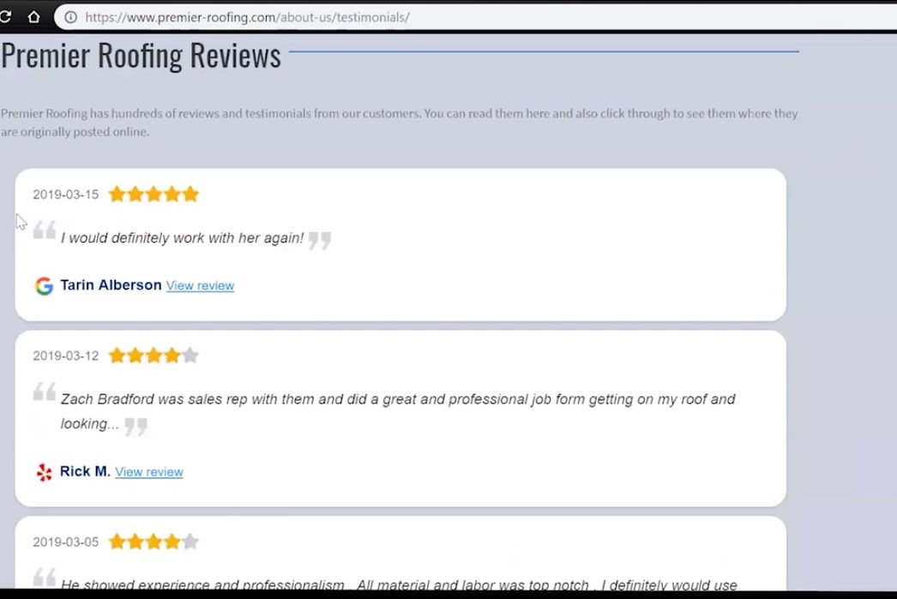
Display all of your positive reviews on your website, from multiple social media sites.

Slide 28
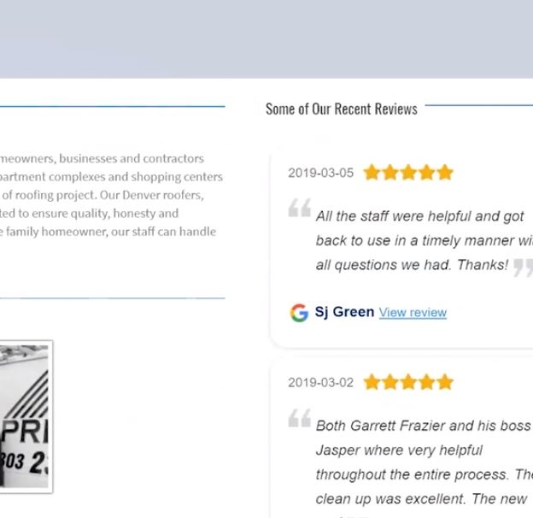

Slide 29
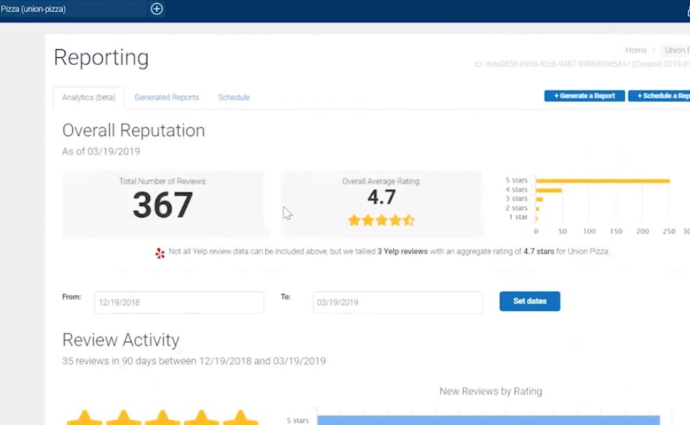

Slide 30
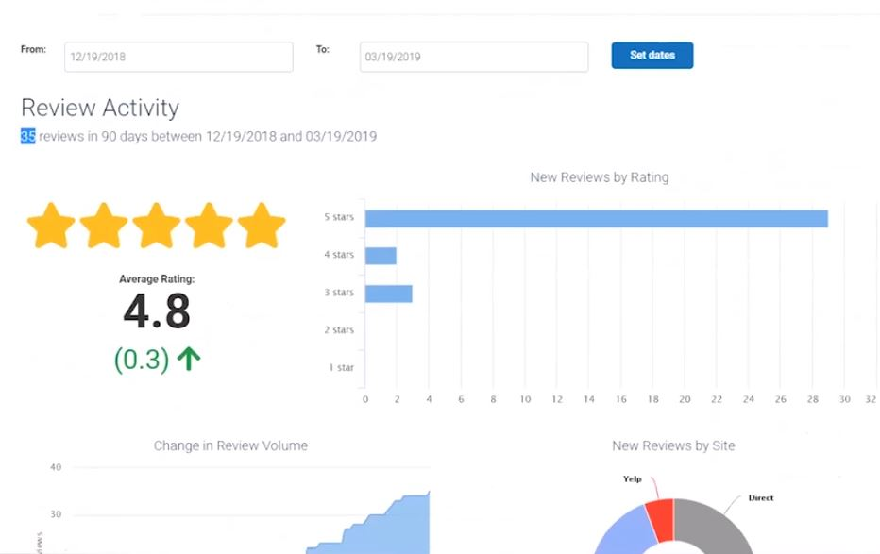

Slide 31
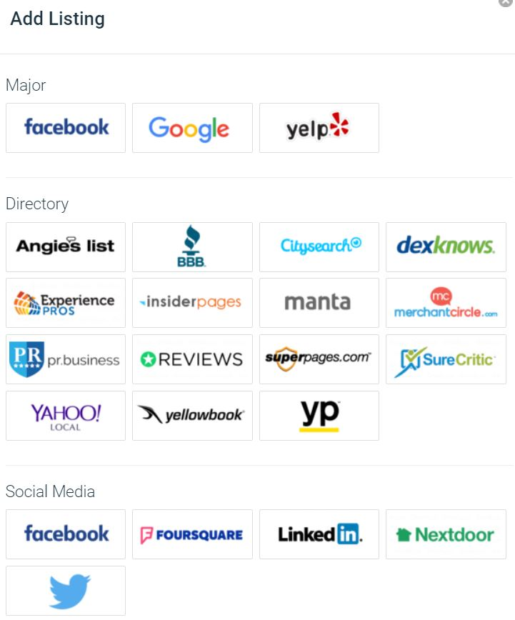
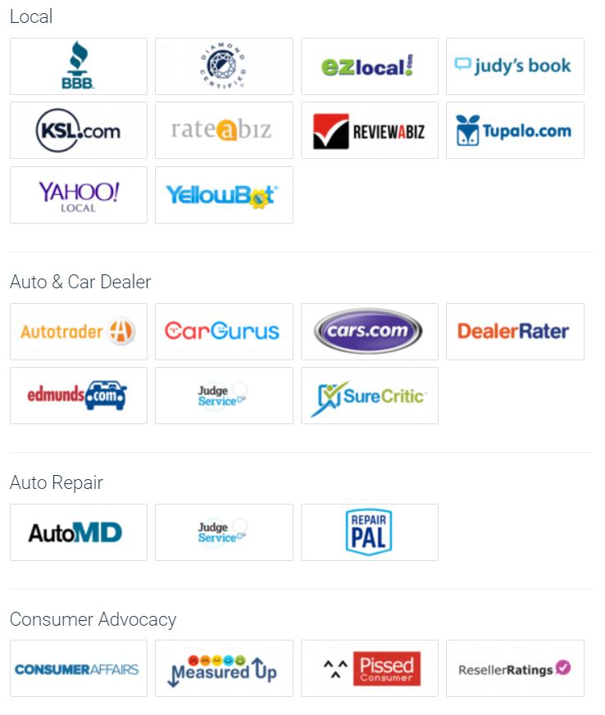
Other Platforms We Post Reviews To:

Slide 32
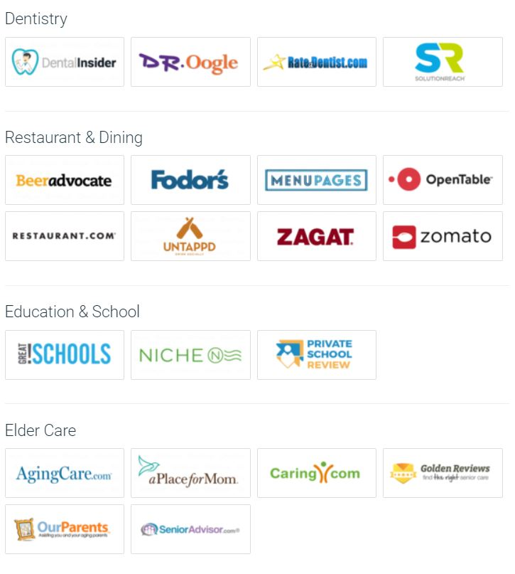
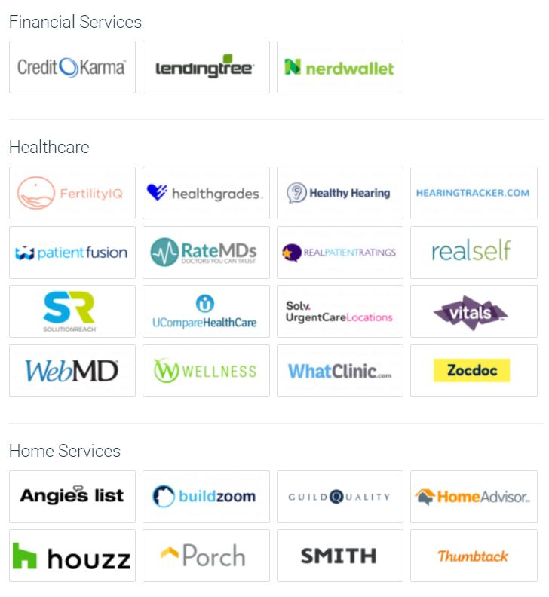
Other Platforms We Post Reviews To:

Slide 33
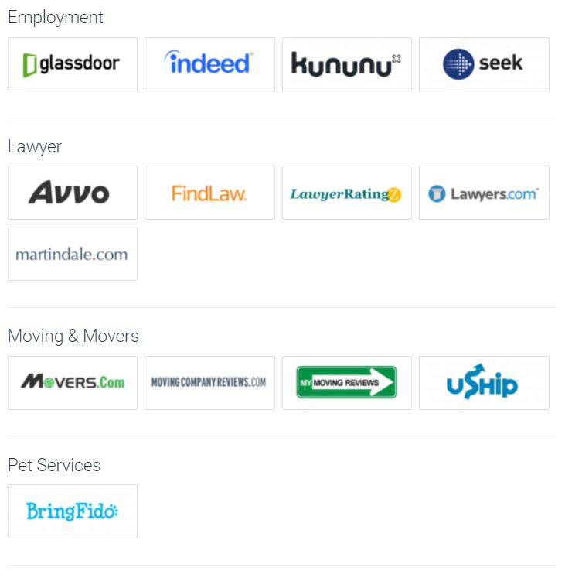
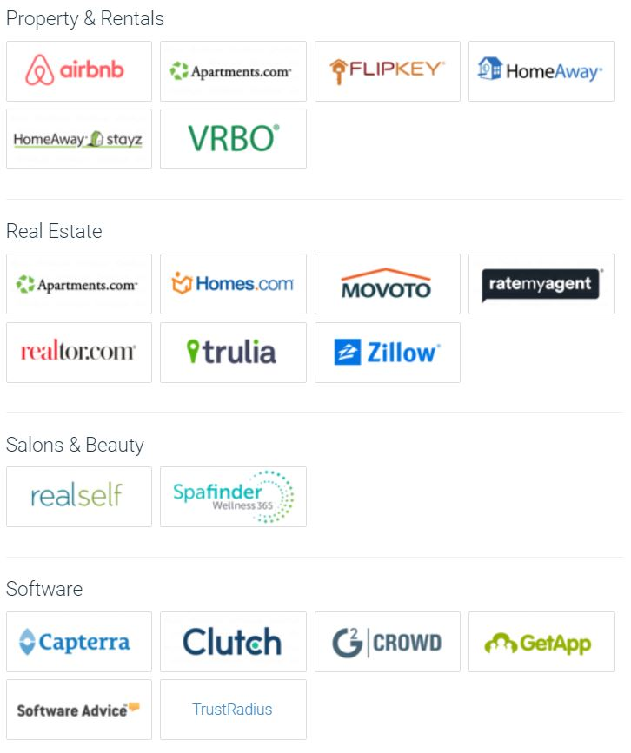
Other Platforms We Post Reviews To:

Slide 34
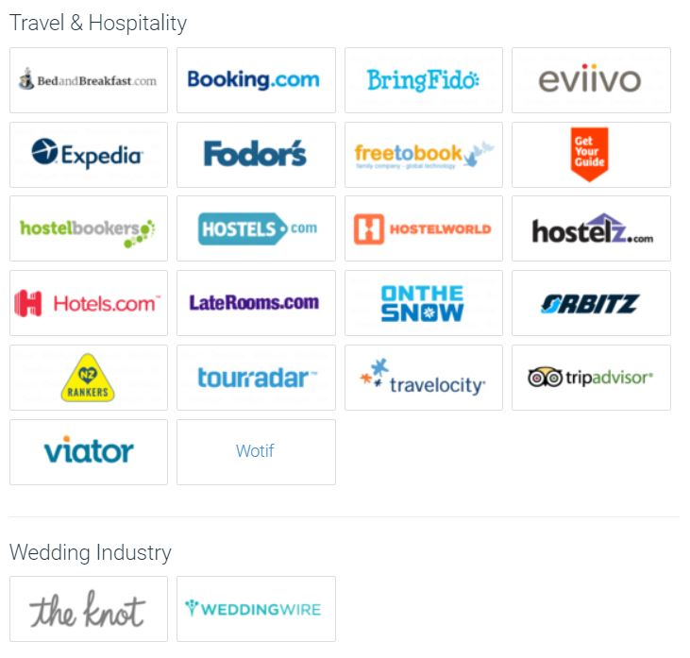
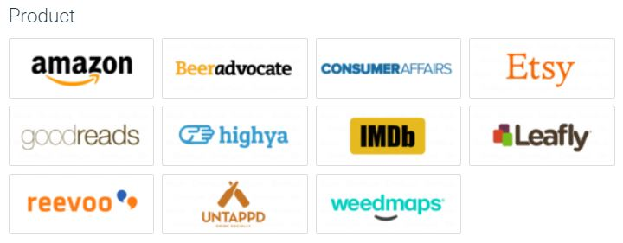
Other Platforms We Post Reviews To:

Slide 35
Outcome: Online Credibility, Better Search Ranking, More Customers, More Revenue.
Next Steps:
Set Up Fee Monthly Recurring Fee (Set-up fee currently waived)
Schedule an Onboarding Call for Campaign Set Up
Schedule Complementary Marketing Strategy Call ($500 Value)
72 hours for Campaign Set Up After Onboarding Call
Launch
GROW YOUR ONLINE VISIBILITY & CREDIBILITY, ATTRACT MORE CUSTOMERS & MAKE MORE SALES!

